Slide 1

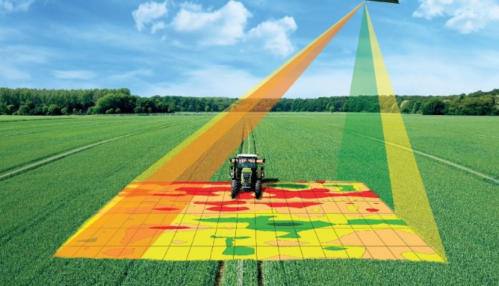
Precision Agriculture Using Convolutional Neural Networks
By: Faith Twardzik

Slide 2

Overview
A research group at University of Illinois developed a new method for processing precision agriculture data, using convolutional neural networks (CNN)
Sections
I) Precision Agriculture
II) Convolutional Neural Networks
III) U of I’s Incorporation of CNN into Predictive Modeling
IV) Comparison of the CNN architectures tested
V) Applications of CNN on Precision Agriculture and Other Fields

Slide 3
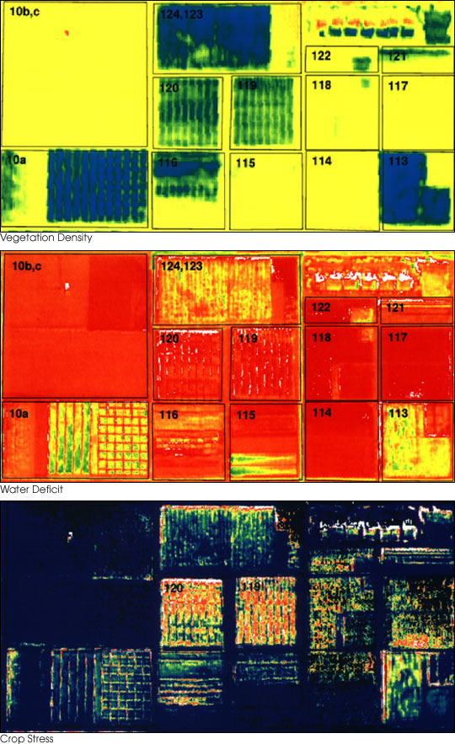
But … What Exactly is Precision Agriculture?
Precision agriculture = $12.9 billion field by 2027
What is it?
Satellite farming (SA), site-specific crop management (SSCM)
A tool for farming management based on
Analysis of past crop yields
Prediction of future crop yields
Identification of factors contributing to crop yield
Optimization of these factors/farming strategies/resources

Slide 4
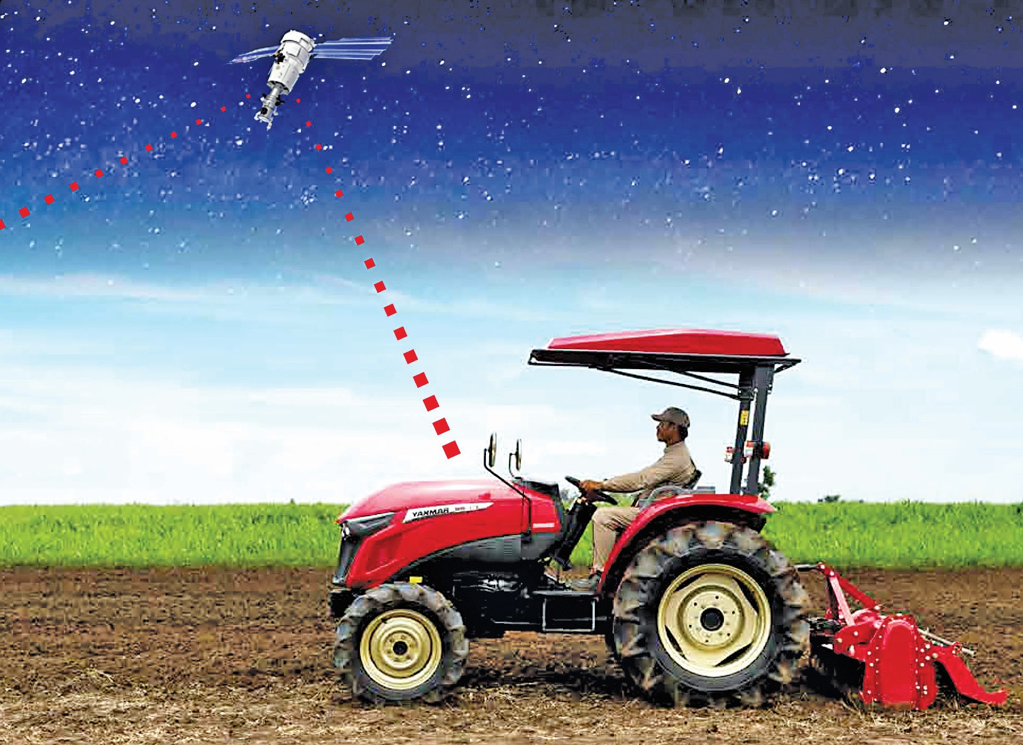

Precision Agriculture
The goal:
Determine a decision support system (DSS) for optimizing crop yields on individual farms by determining the optimal usage strategies for resources (fertilizer/irrigation/tilling/cropping)
How?
Step 1: Geolocation
Use GPS technologies or satellite/aerial imaging to visually and spatially map farm’s characteristic distribution

Slide 5
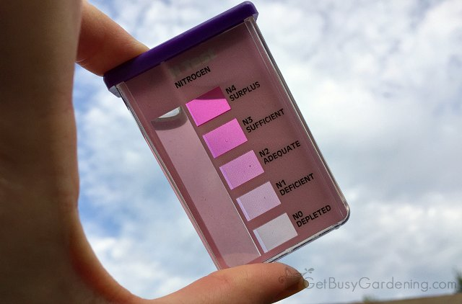
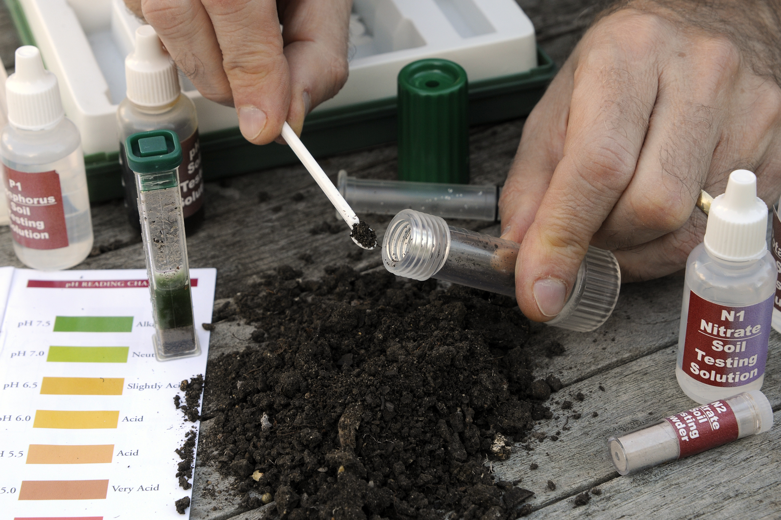
More Precision Agriculture
Step 2: Measure/Analyze Variables
Variable affecting crop yield include:
Climate (amount of sunlight, rain, etc.)
Soil (texture, richness, nitrogen/potassium rates)
Cropping methods (no-till, cover crop, crop rotation, etc.)
Amount/type of weeds, disease prevalence, hydrology of land, moisture content
How are they measured?
Sensors & Tests: soil resistivity, moisture content
Weather stations: climatic changes
Remote sensing: temperature, humidity

Slide 6
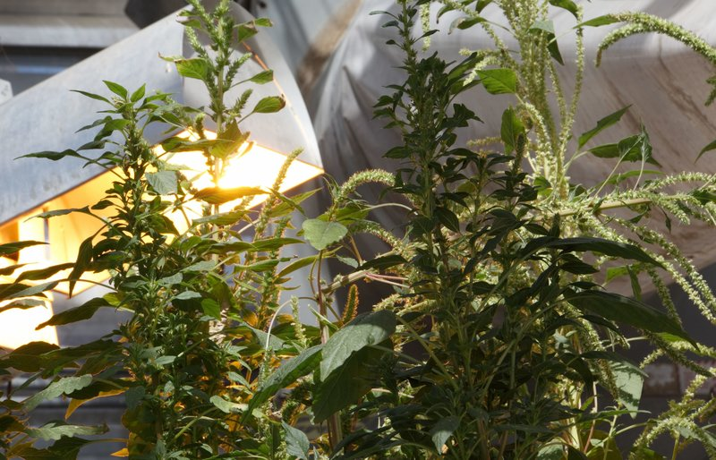
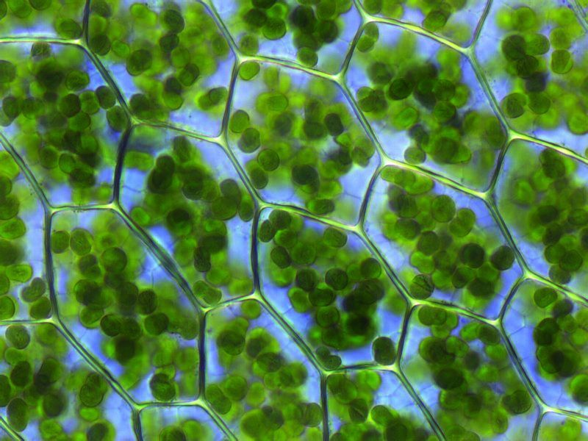
Even More Precision Agriculture??
Step 3: Measure Ongoing Crop Yield/Health
Mix of predictive approach (using static indicators such as soil health, overall climate, past yields) & control approach (using ongoing measurements of crop growth)
Control Approach methods:
Proxy-detection: vehicle sensors measure stem size, leaf size/health/residue/disease
Sampling: weighing biomass, measuring chlorophyll
Aerial/Satellite remote sensing: distribution of weeds, development of disease

Slide 7
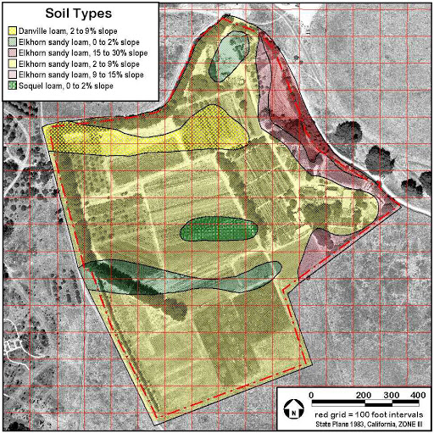
Yes … MORE Precision Agriculture!
Step 4: Create Predictive Models
This is where CNN comes in!
Use measurements/history to create models that optimize crop yields based on cropping techniques
Cropping style (no-till/partial-till, crop rotation, cover crops, etc.)
Step 5: Implement DSS Practices
Use GIS to map new practices and VRT (variable rate technologies) to implement

Slide 8


On to the FUN Stuff … CNN Models?!
This U of I team is revolutionizing precision agriculture techniques by using CNN models
But ... What is a CNN Model?
Let’s go on a brief detour!

Slide 9

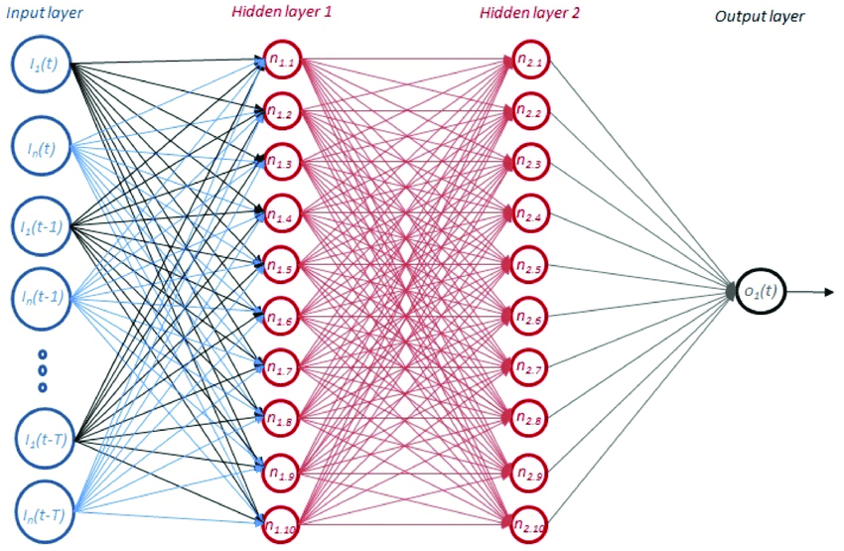

A Very … VERY Brief Intro to CNN
CNN = Convolutional Neural Network
Modeled off of the neural networks in the human brain
THE IDEA:
Neural networks use nodes/neurons & inputted data to learn naturally
No existing programmed “rules” or patterns

Slide 10
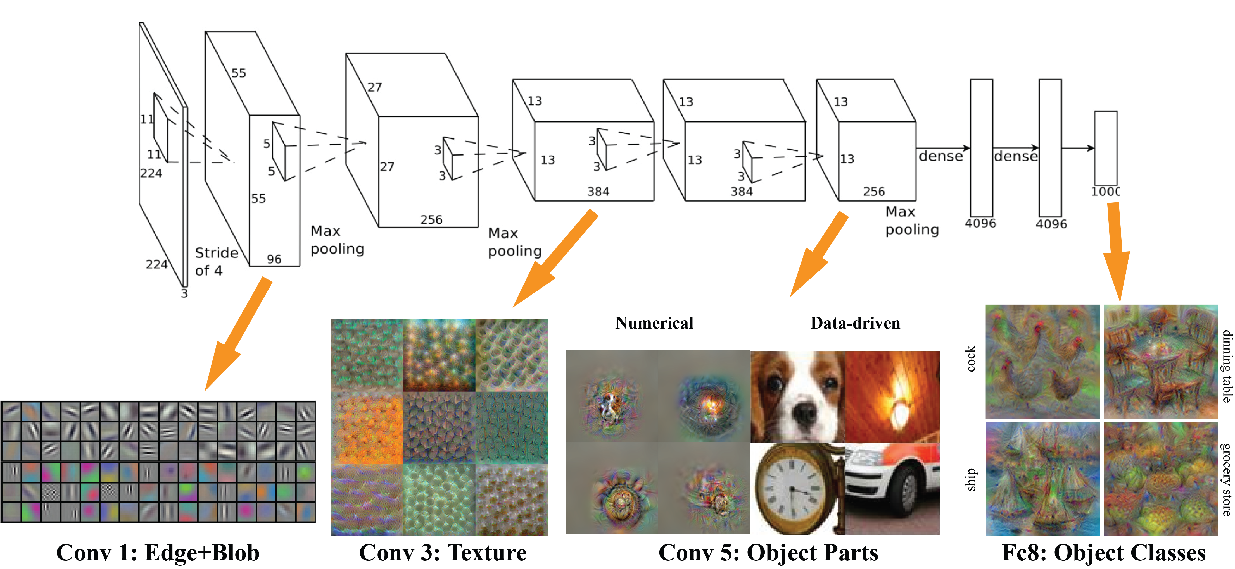
The Good, the Bad, the … CNN?
A CNN’s Guts:
Neurons: receive an input, use an activation function to generate output function to be sent to other neurons
Input = data such as visual images
Connections: connects one neuron’s output to another neuron’s input
Given “weights” to indicate importance
Learning: Adjusts weights of connections to improve accuracy

Slide 11

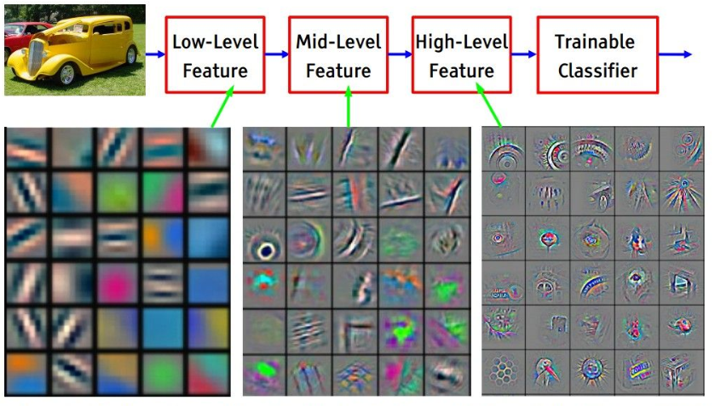
Convoluted Stuff on the Convolutional NN!
Propagation Function: Uses neuron’s output and connection weight to generate input to next neuron
Layers:
Input layer, output layer, and hidden layers
Neurons in each layer, connections mapping neurons of one layer to next in between layers
Fully-connected: one-to-one connection of neuron in one layer to next
Pooling: Many-to-one connection of many neurons in one layer to one in next

Slide 12
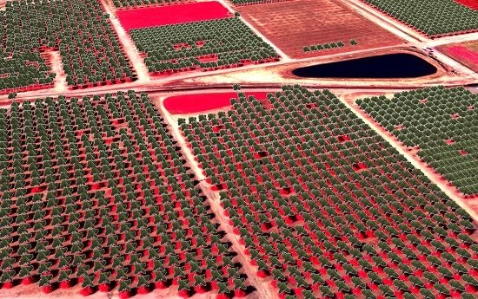

CNNs for Precision Agriculture
Previously been used for image classification (ANALYSIS):
Amount/Type of diseases/weeds/plants/soil in aerial & satellite imagery
This Study:
Recorded crop yield based on nutrient input (nitrogen/fertilizer), seed rate, and other variables
Created a PREDICTIVE MODEL (CNN)
Used model to predict result of nitrogen and seeding rates before their application in order to determine the optimal rates of these variables

Slide 13
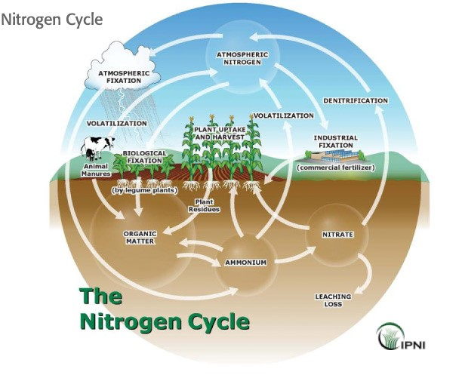
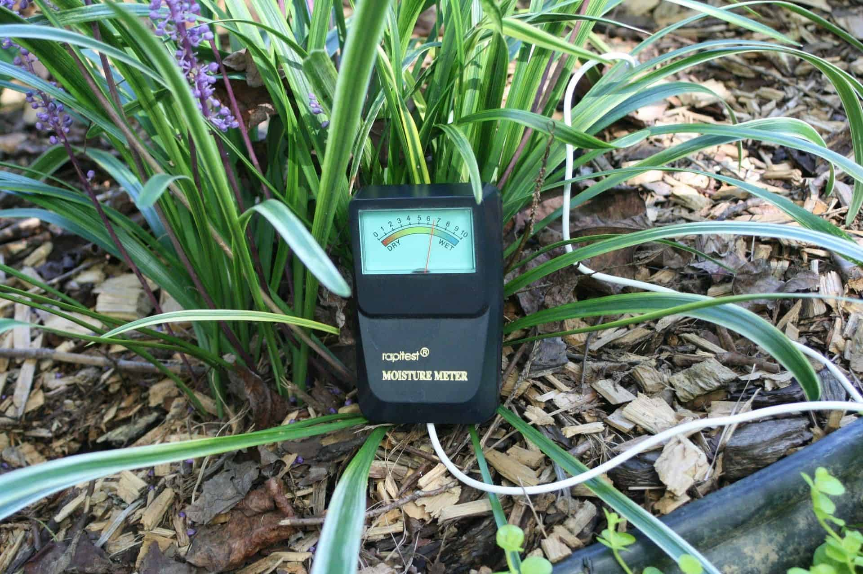
The Dataset & Variable
Variables Measured/Studied:
Nitrogen rates
Seeding rates
Elevation
Soil EC (electroconductivity)
Soil texture, density
Organic chemistry, moisture content
Salinity, cation exchange capacity
Nine fields were studied, each with varied types/amounts of the above variables, and the crop yield data was used as the “response” (dependent) variable

Slide 14
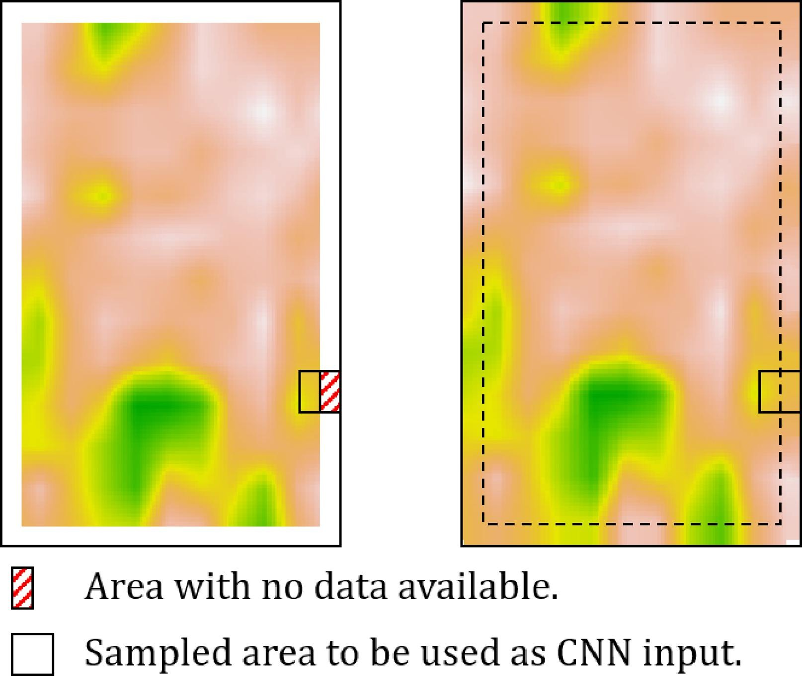
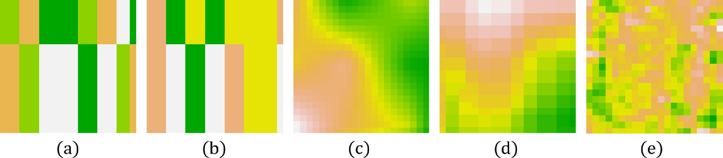
Building the CNN
Since a CNN is built from image inputs (think about image recognition where pictures labeled ‘dog’ or ‘not dog’ are fed into the CNN so that it can recognize a picture that is a dog based on previous pictures of dogs)
This CNN used rasterized images of the variable distribution
Nitrogen and Seed rates → polygon maps
Elevation and Soil EC → point data maps
Visual Characteristics → satellite image
Using GIS rasterization, these maps became input for CNN

Slide 15
Hyperdrive? No! … Hyperparameters: The Different CNN Architectures
Group tested 4 different architecture types for the CNN model:
1) ST network, uses stacking, sixteen-filter layer and 2 max-pooling layers, outputs sent to two fully-connected ReLu layers (512 neurons)
2) Early-Fusion network, each input corresponds to a convolutional layer with an eight-filter layer and max-pooling layer, outputs sent to fully-connected ReLu layer (16 neurons)
3) Late Fusion network, same as last except addition of 16 neurons after max-pooling layer, then 1 ReLu neuron, sent to last two fully-connected ReLu layers
4) 3D CNN same as ST except with 3 x 3 x 1 filters

Slide 16
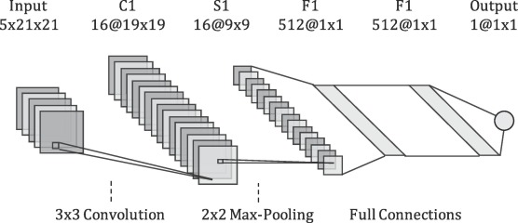
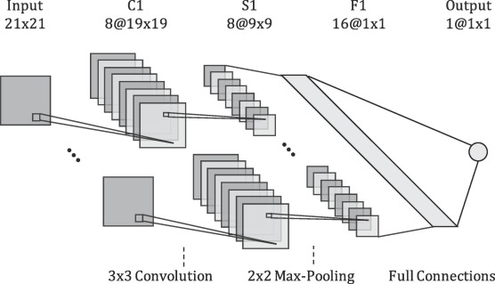
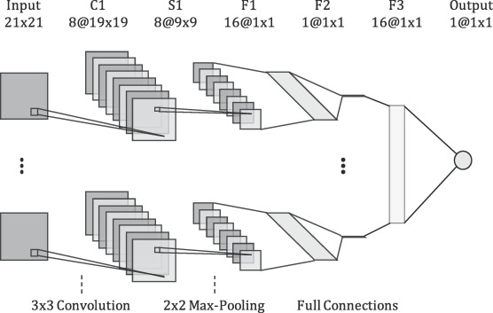
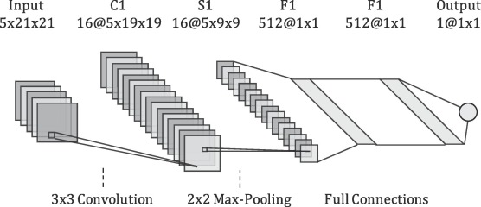
CNN ST
CNN EF
CNN LF
CNN 3D

Slide 17
Evaluating the Results of the CNN
One CNN model was created for each individual field
These models were tested against already well-known models
How?
The models are run with their inputs
The outputs (predicted crop yield based on amounts of variables) are compared with actual crop yields with the same amounts of variables
Uses an RMSE value (fraction of standard deviation from actual crop yield)
A lower RMSE indicates more accuracy
RMSE Chart
on Next Page!

Slide 18
Results of CNN Architectures
Field | RMSE |  |  |  |  |  |  |  | Yield [kg/ha]
 | MLR | FC | LF | EF | 3D | ST | SVM | RF | Stdv. | Mean
1 | 1.53 | 0.97 | 0.66 | 0.73 | 0.75 | 0.69 | 0.86 | 0.92 | 3240 | 12500
2 | 1.29 | 0.88 | 0.83 | 0.86 | 0.87 | 0.88 | 0.86 | 0.90 | 2290 | 10700
3 | 1.90 | 0.63 | 0.58 | 0.58 | 0.59 | 0.60 | 0.86 | 0.59 | 1230 | 14400
4 | 1.03 | 0.76 | 0.75 | 0.78 | 0.77 | 0.77 | 0.77 | 0.76 | 900 | 12200
5 | 0.74 | 0.72 | 0.70 | 0.72 | 0.75 | 0.73 | 0.76 | 0.70 | 1360 | 14500
6 | 1.09 | 0.51 | 0.48 | 0.51 | 0.53 | 0.56 | 0.58 | 0.52 | 1140 | 14700
7 | 0.75 | 0.72 | 0.69 | 0.70 | 0.71 | 0.73 | 0.76 | 0.73 | 1150 | 15700
8 | 1.11 | 0.94 | 0.94 | 0.94 | 0.94 | 0.94 | 0.89 | 0.96 | 2267 | 14100
9 | 1.10 | 0.69 | 0.63 | 0.65 | 0.66 | 0.66 | 0.67 | 0.63 | 1140 | 12600
Avg. | 1.17 | 0.76 | 0.70 | 0.72 | 0.73 | 0.73 | 0.78 | 0.75 | 1635 | 13489

Slide 19
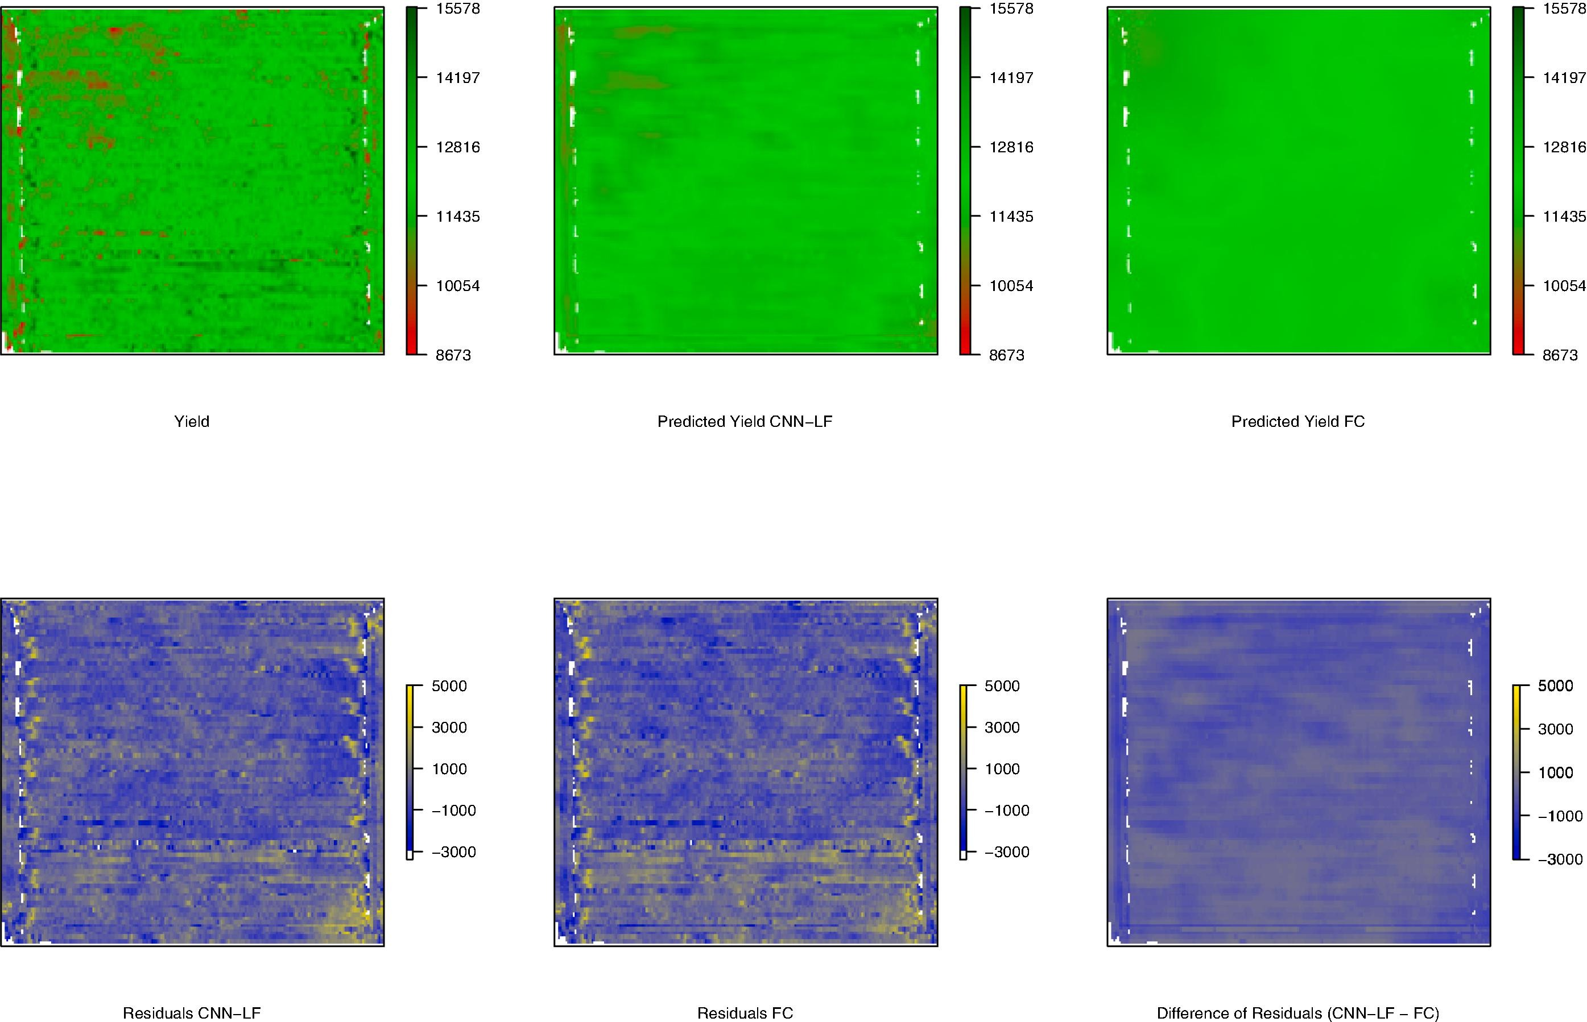
Take-Aways
The CNN-LF (Late Fusion) model had the lowest RMSE values
These values were much lower than the other models currently being used for precision agriculture (random forest (RF), support vector machine (SVM), etc.)
CNN Models work for Precision Agriculture … and WELL!

Slide 20

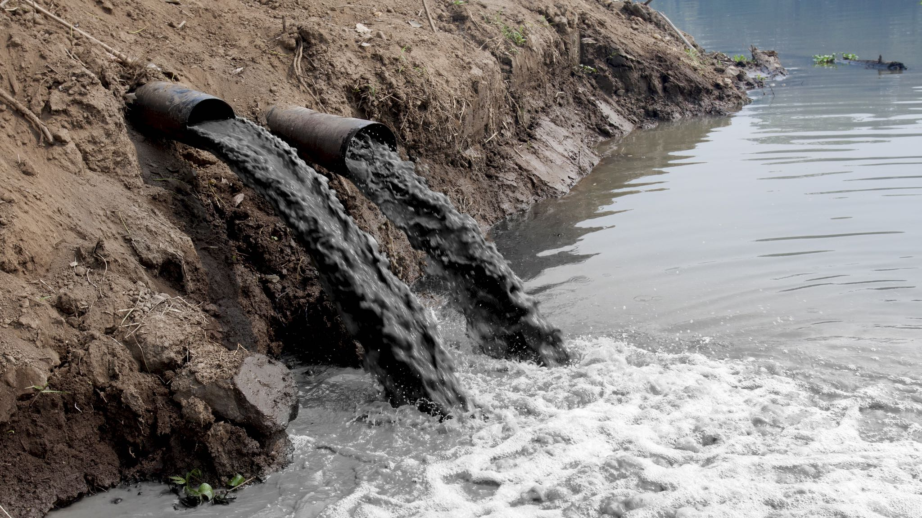
But … What Does It All Mean?
Using CNN models to vary the rates of nitrogen/seed use and measuring the predicted crop yield will help farmers optimize the amount and distribution of nitrogen/seeds
How is this helpful?
Economic: decreases wasted/unnecessary/harmful usage of nitrogen & seeds
Environmental: decreases nitrogen run-off, water-body contamination
Applicational: CNN models can now be used for any variables – irrigation, pesticide usage, disease-prevention chemicals, other fertilizers like potassium, types of tilling

Slide 21

Applications of CNNs beyond Precision Agriculture
The possibilities are endless … given images with spatial distribution, creates predictive models based on the result of spatial variables
Business Placement:
To determine if a location is optimal for business, feed in images of locations with similar characteristics (neighboring businesses, geographic landmarks, climate) and the success of these businesses, then run on current location

Slide 22
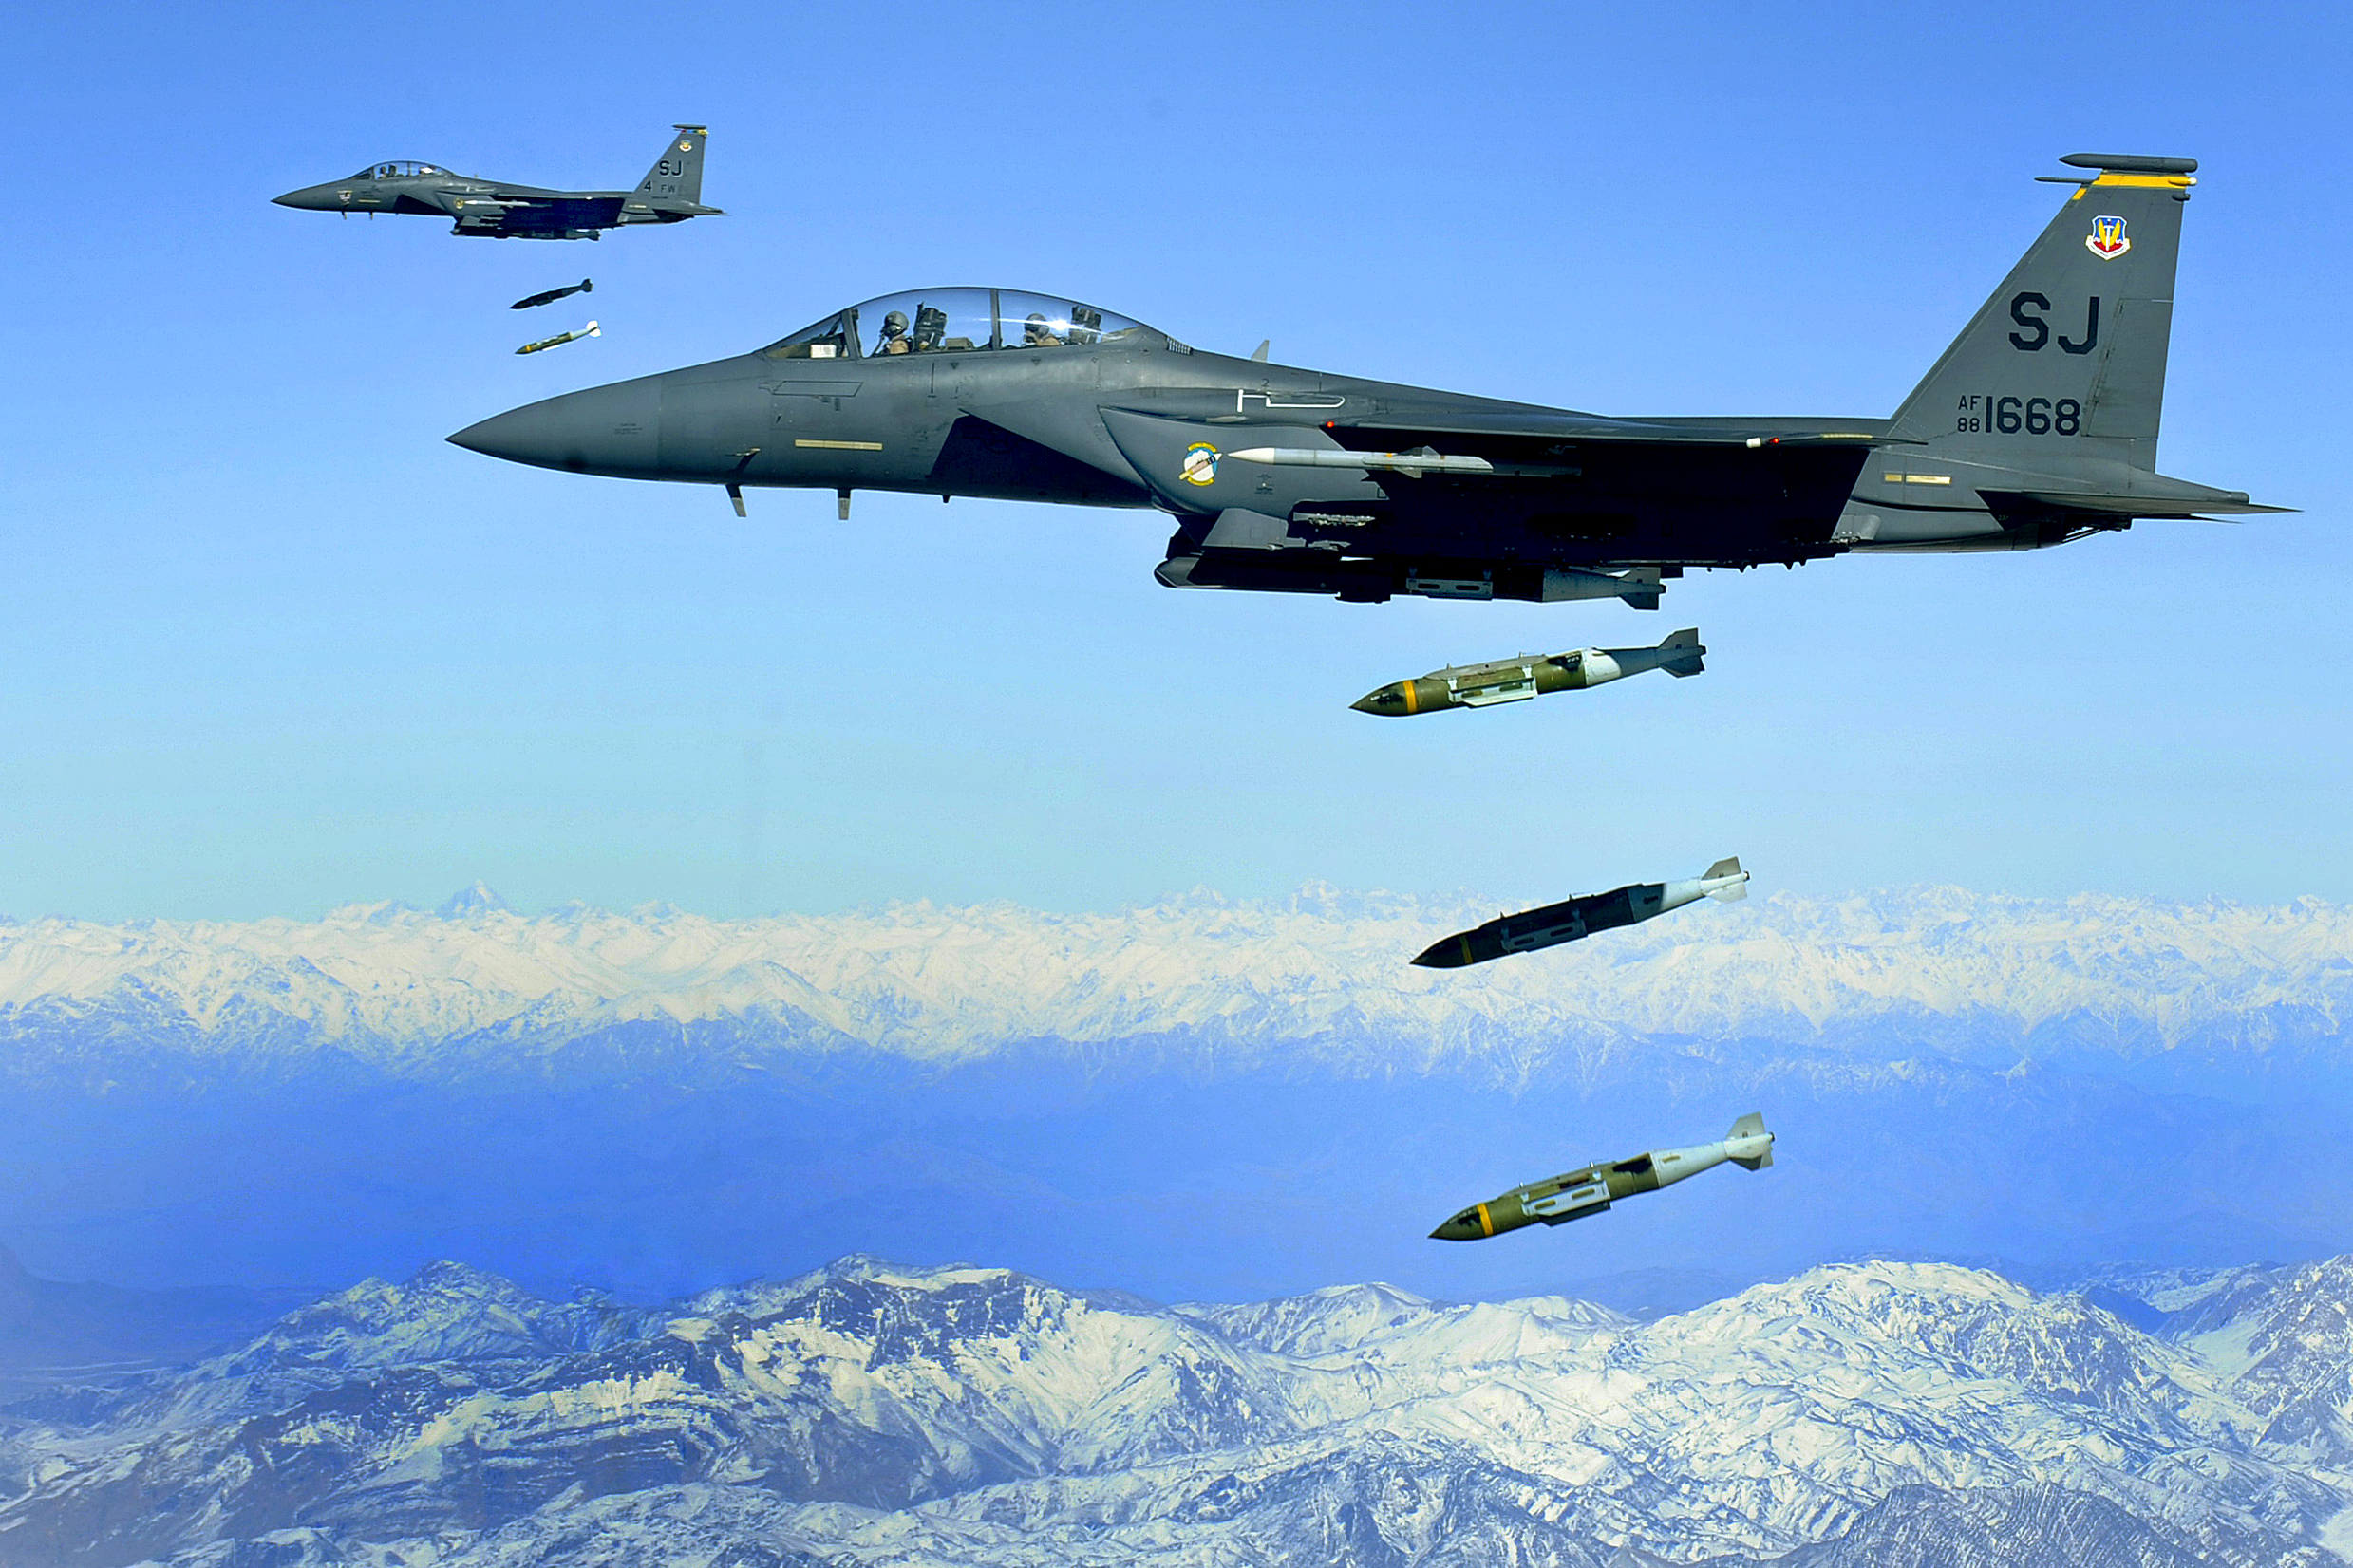
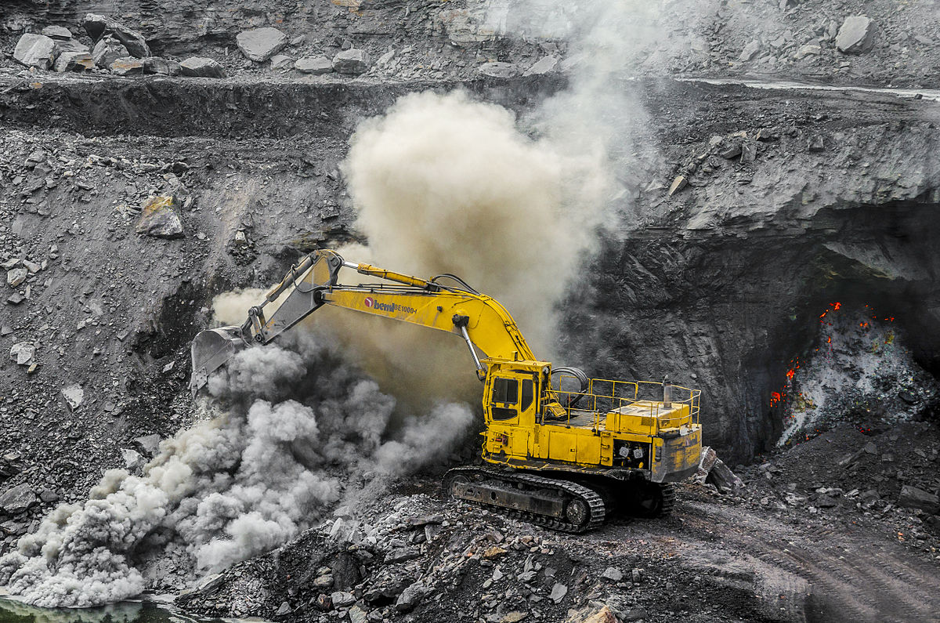
MORE Applications??
Military:
To determine airstrike/raid locations, feed in images of past airstrike/raid locations with similar characteristics and the success of the operation, then run on current location
Resource Location:
For mining, oil drilling, logging, fishing, and other natural resource extraction, feed in locations and yield, to see if positive correlation can be made between location (spatial surface features) and the resource being sought

Slide 23
Citation Links!
“New artificial intelligence algorithm better predicts corn yield”
https://aces.illinois.edu/news/new-artificial-intelligence-algorithm-better-predicts-corn-yield
“Modeling yield response to crop management using convolutional neural networks”
https://www.sciencedirect.com/science/article/pii/S0168169919308543?via%3Dihub#f0010
“Precision Agriculture”
https://en.wikipedia.org/wiki/Precision_agriculture
“Convolutional Neural Network”
https://en.wikipedia.org/wiki/Convolutional_neural_network
“Artificial Neural Network”
https://en.wikipedia.org/wiki/Artificial_neural_network

Slide 24
Formatted Citations!
“Artificial Neural Network.” Wikipedia, Wikimedia Foundation, 10 Mar. 2020, en.wikipedia.org/wiki/Artificial_neural_network.
Barbosa, Alexandre, et al. “Modeling Yield Response to Crop Management Using Convolutional Neural Networks.” Computers and Electronics in Agriculture, Elsevier, 12 Feb. 2020, www.sciencedirect.com/science/article/pii/S0168169919308543.
“Convolutional Neural Network.” Wikipedia, Wikimedia Foundation, 10 Mar. 2020, en.wikipedia.org/wiki/Convolutional_neural_network.
“Precision Agriculture.” Wikipedia, Wikimedia Foundation, 20 Feb. 2020, en.wikipedia.org/wiki/Precision_agriculture.
Quinn, Lauren. “New Artificial Intelligence Algorithm Better Predicts Corn Yield.” College of Agricultural, Consumer and Environmental Sciences, 20 Feb. 2020, aces.illinois.edu/news/new-artificial-intelligence-algorithm-better-predicts-corn-yield.

